Slide 1
Management System for Students
SOFTWARE ENGINEERING PROJECT BINF III/A

Slide 2
Distributions of main roles and tasks
Team Members:
Alesia Jamaku | Engineer in charge of quality assurance will test the app to make sure it complies with specifications and is error- and bug-free. They will collaborate closely with the database, middleware, front-end, and back-end engineers to test each part of the project and make sure it functions properly.
Amarda Jamaku | Middleware Developer: This person is in charge of creating the middleware, which links the front-end and back-end elements of the project. In addition to managing API requests, connecting other services, and guaranteeing data consistency between the front-end and back-end, they will be in charge of these tasks.
Anjeza Ndoci | Back-end The developer is in charge of creating the server-side Python logic for the application, as well as managing the database and adding user authentication and security measures.
Agustin Kola | Front-end The app's user interface will be designed and developed by the developer using HTML, CSS, and JavaScript. Additionally, they will be in charge of putting user interactions into place and making sure the app is responsive and user-friendly.
Rugers Beci | The database developer is in charge of creating and maintaining the database's schema, as well as monitoring and improving
Leader of the Group: STUDENT | ANJEZA NDOCI
6 MEMBERS

Slide 3
DESCRIPTION OF THE APP
01
03
CONSIDERING
THIS PROJECT
THE AIM OF
02
that doing this process manually takes at least two applications, it became necessary to develop a software application that automates only a new one that both students and advisors can use. and facilitates this process.
introduces a software application to provide a new management system for the students and the advisors.
This project is to help universities or schools to provide a better way of finding them so that it is easily accessible by the students and that absences and grades are both clear.

Slide 4
USER REQUIREMENTS AND APPLICATION SPECIFICATIONS
SOFTWARE ENGINEERING PROJECT BINF III/A

Slide 5
PHASE II
01

Slide 6
About us
What are we?
What we can provide?
On this project we are working on a software application that aims to provide a new management system for students and advisors in universities or schools. The application will automate the process of finding information related to absences and grades, and it will be easily accessible to both students and advisors.
With this application, we can improve the efficiency and accuracy of the management process by eliminating the need for manual processes and reducing the likelihood of errors. Additionally, it can save time and resources, allowing advisors and students to focus on other essential tasks.

Slide 7
To ensure the success of this project, you may consider the following steps:
Define the requirements of the software application by gathering feedback from students and advisors.
Create a detailed design of the application, including its functionality,
interface, and database structure.
Develop and test the software application, ensuring that it meets the requirements and is user-friendly.
By following these steps, we can ensure the successful development and deployment of the software application, which can provide a better way of managing information related to absences and grades for students and advisors in universities or schools.
Deploy the application in a controlled environment and test it thoroughly to ensure that it performs as expected.
Train the users on how to use the application, and provide technical
support as needed.

Slide 8
User Requirements
SOFTWARE ENGINEERING PROJECT BINF III/A

Slide 9
Students should be able to view their absences and grades for each course they are enrolled in.
The application should be easily accessible to both students and advisors.
Advisors should be able to view the absences and grades of their advisees for each course.
The app should be:
customizable to fit the specific needs of each university or school.
user-friendly and easy to navigate.

Slide 10
Application Specifications
SOFTWARE ENGINEERING PROJECT BINF III/A

Slide 11
have a search function to quickly find information.
have a database to store student and course data.
The app should:
be web-based and accessible via a browser.
have an admin panel for administrators to manage the system.

Slide 12
Reliability Requirement
Usability Requirement
The system shall allow the users to access the system from their personal computer. Since all users are familiar with the general usage of a PC, no special training is required. The system’s interface has to be user-friendly and easy to use.
The system should be 100% reliable because it logs in using the company’s credentials.

Slide 13
RequirementsSpecifications
SOFTWARE ENGINEERING PROJECT BINF III/A

Slide 14
Functional Requirements
User Registration
Course Enrollment
Grade Management:
The application should allow students and advisors to create accounts using their university or school email addresses and set up passwords to access the system.
The application should allow students to enroll in courses
The application should allow advisors to record students'
grades for assignments, quizzes, and exams in each course

Slide 15
Other non Functional Requirements
Safety Requirements
Security Requirements
Software Quality Attributes
Business Rules
The software is required to provide consistent and reliable information to the User.
The system should maintain a fine level of security against unauthorized access, authorization and authentication should be provided. Only the users who have access to the system should be able to view the information.
To ensure that the software program operates correctly at all times, frequent efforts are performed. The maintenance expenses are anticipated to be minimal when taking into account the software's architecture, design, implementation, and documentation.
It is required that the users must not share the software with anyone outside the organization as it contains credentials of the company Other Requirements

Slide 16
External Stakeholders
Parents and Guardians: Parents and guardians of students could be impacted by this software application as they may have access to their child's grades and attendance records, enabling them to stay more informed and involved in their child's academic progress.
Accreditation Agencies: Accreditation agencies could benefit from the improved record-keeping and reporting that this software application could provide, enabling them to assess the quality of the university or school more accurately.
Potential Employers: Potential employers may also be impacted by this software application, as it could provide more transparent and accessible information about a student's academic record and performance, making it easier for them to evaluate job candidates.
Government Agencies: Government agencies responsible for regulating
education standards and policies could benefit from the data and analytics that this software application could provide, enabling them to make more informed
decisions and policies.
Third-Party Vendors:
Third-party vendors, such as textbook publishers or educational technology providers, could also be impacted by this software application if it integrates with their products or services.

Slide 17
PHASE III
02

Slide 18
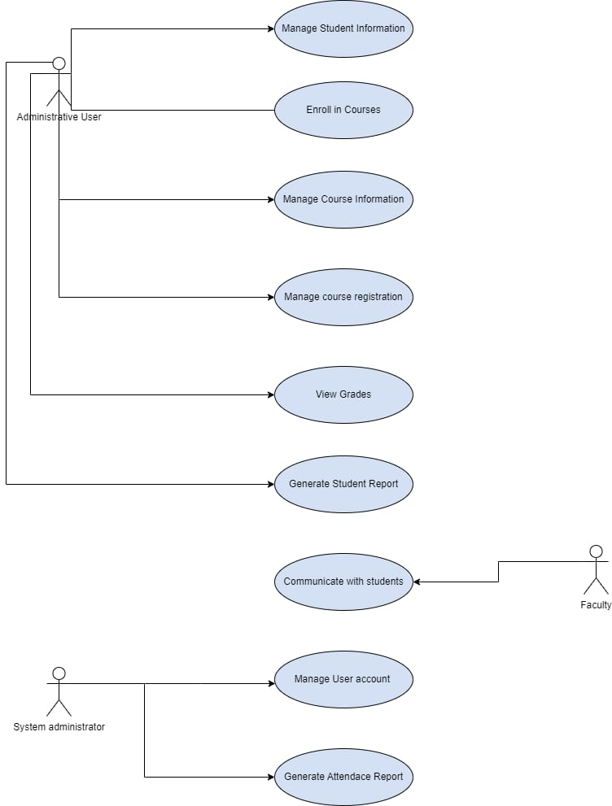
Explanation:
Software design and modeling
Use Case Diagram
To start the system and enter the student data, the administrator user clicks the icon.
Next, the system administrator controls the photos associated with user accounts and gathers the data.
And it's the faculty who serve as the students' point of cont

Slide 19
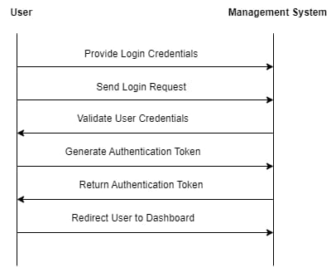
Explanation:
Software design and modeling
Sequence Diagram
The user sends a login request and credentials to the system in the initial interaction.
The return message is shown as a dashed line. The controller will verify user credentials after identifying them and making a request.

Slide 20
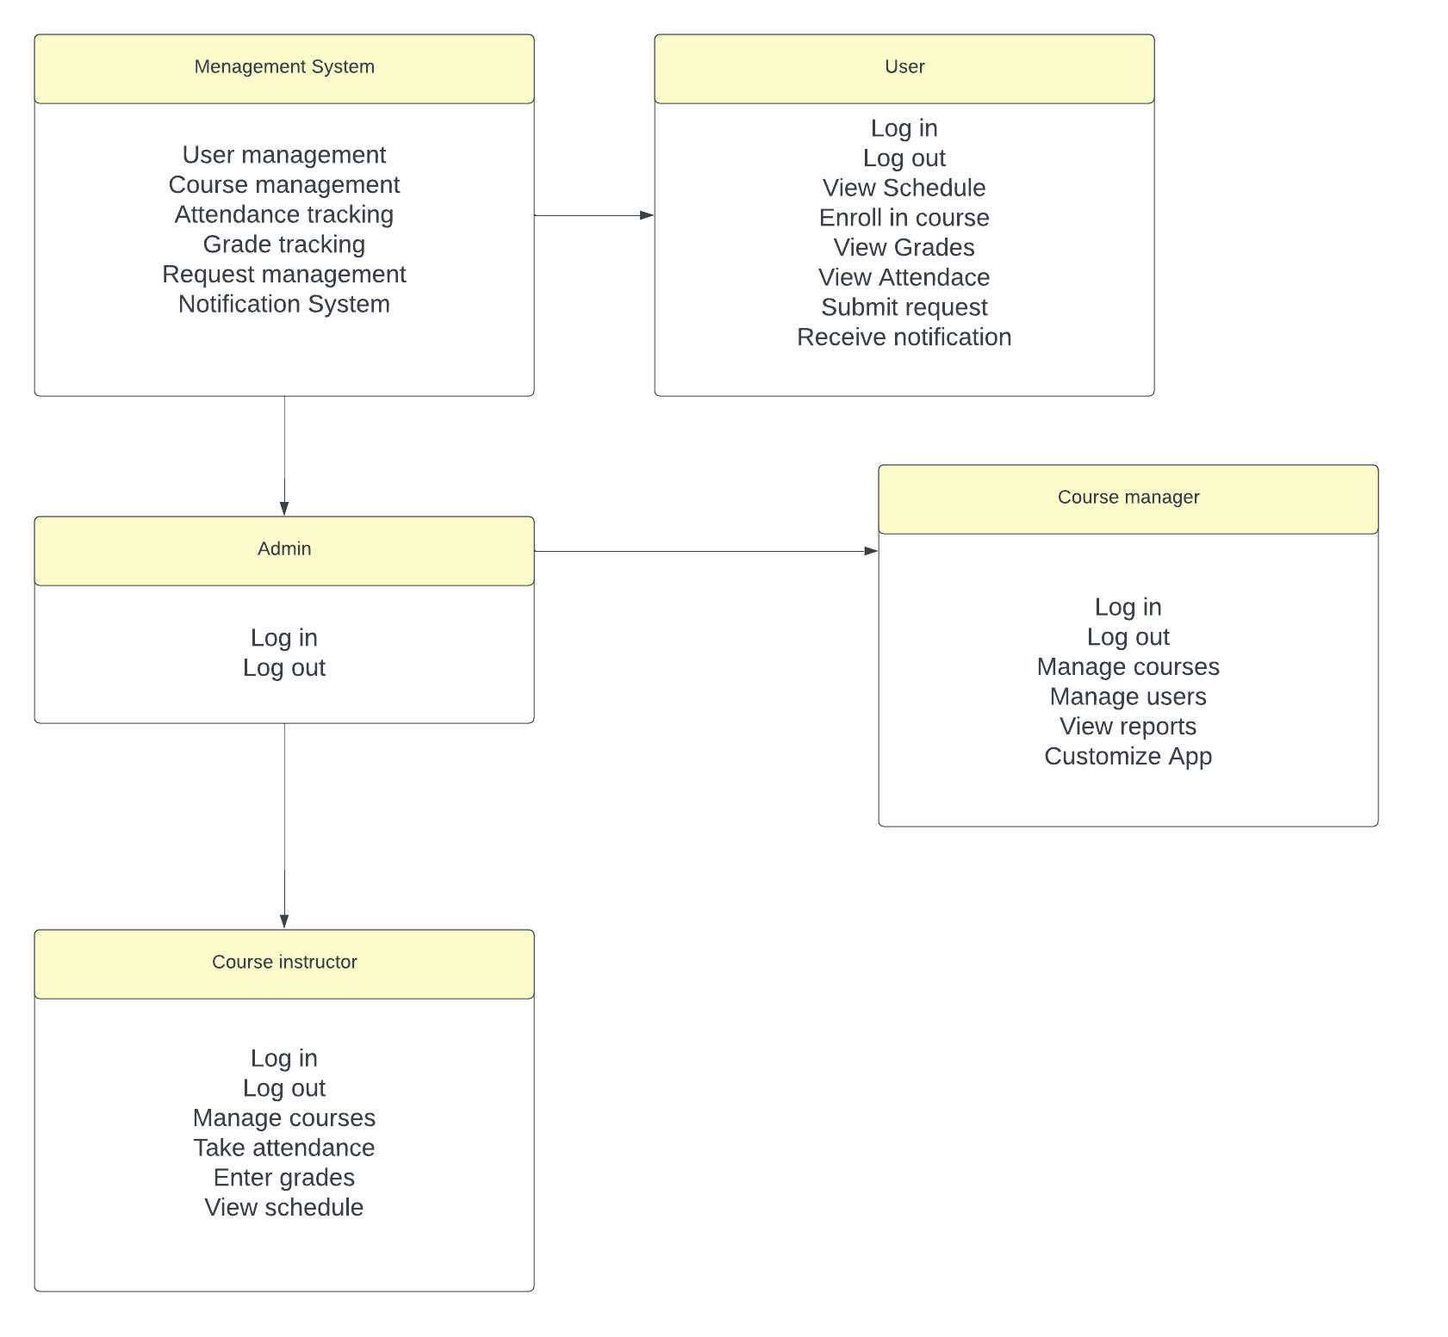
Explanation:
Software design and modeling
Class Diagram
A function in the management system class asks the user for the URL of the filtered website. then gives it back to the controller. The admin class acts as a liaison between the course manager and instructor.

Slide 21
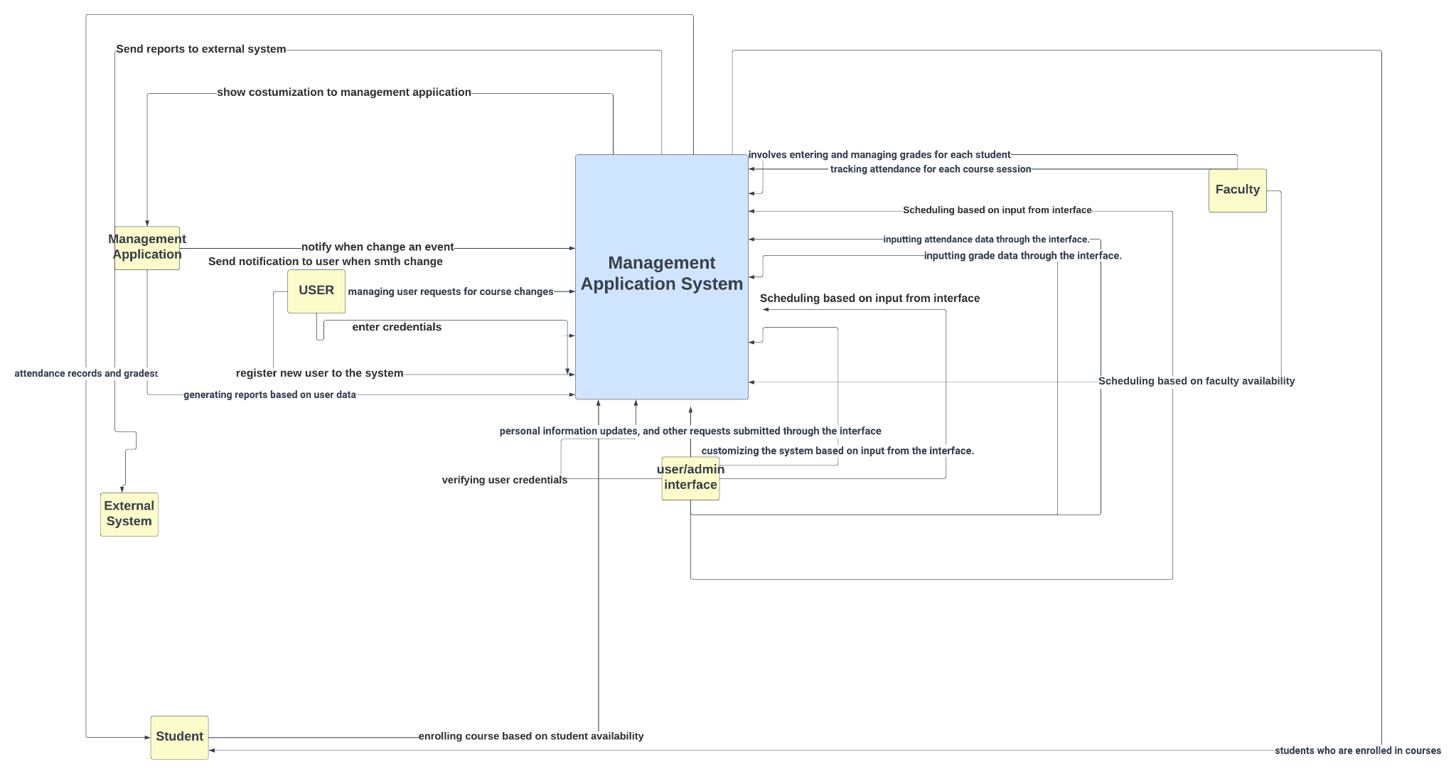
Software design and modeling
Contex Model

Slide 22
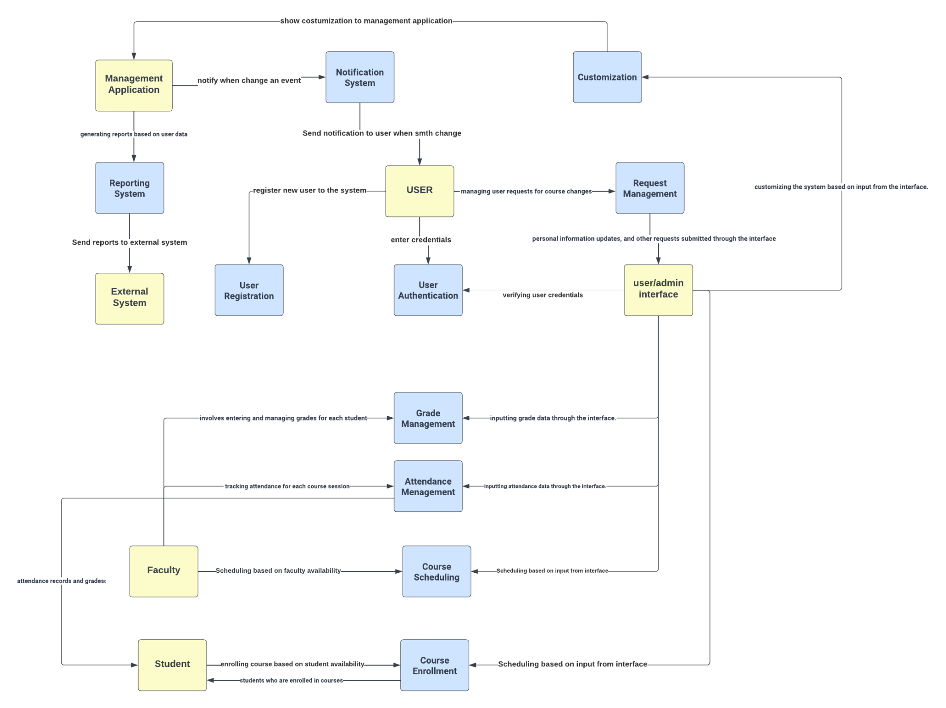
Software design and modeling
Data-Driven Model

Slide 23
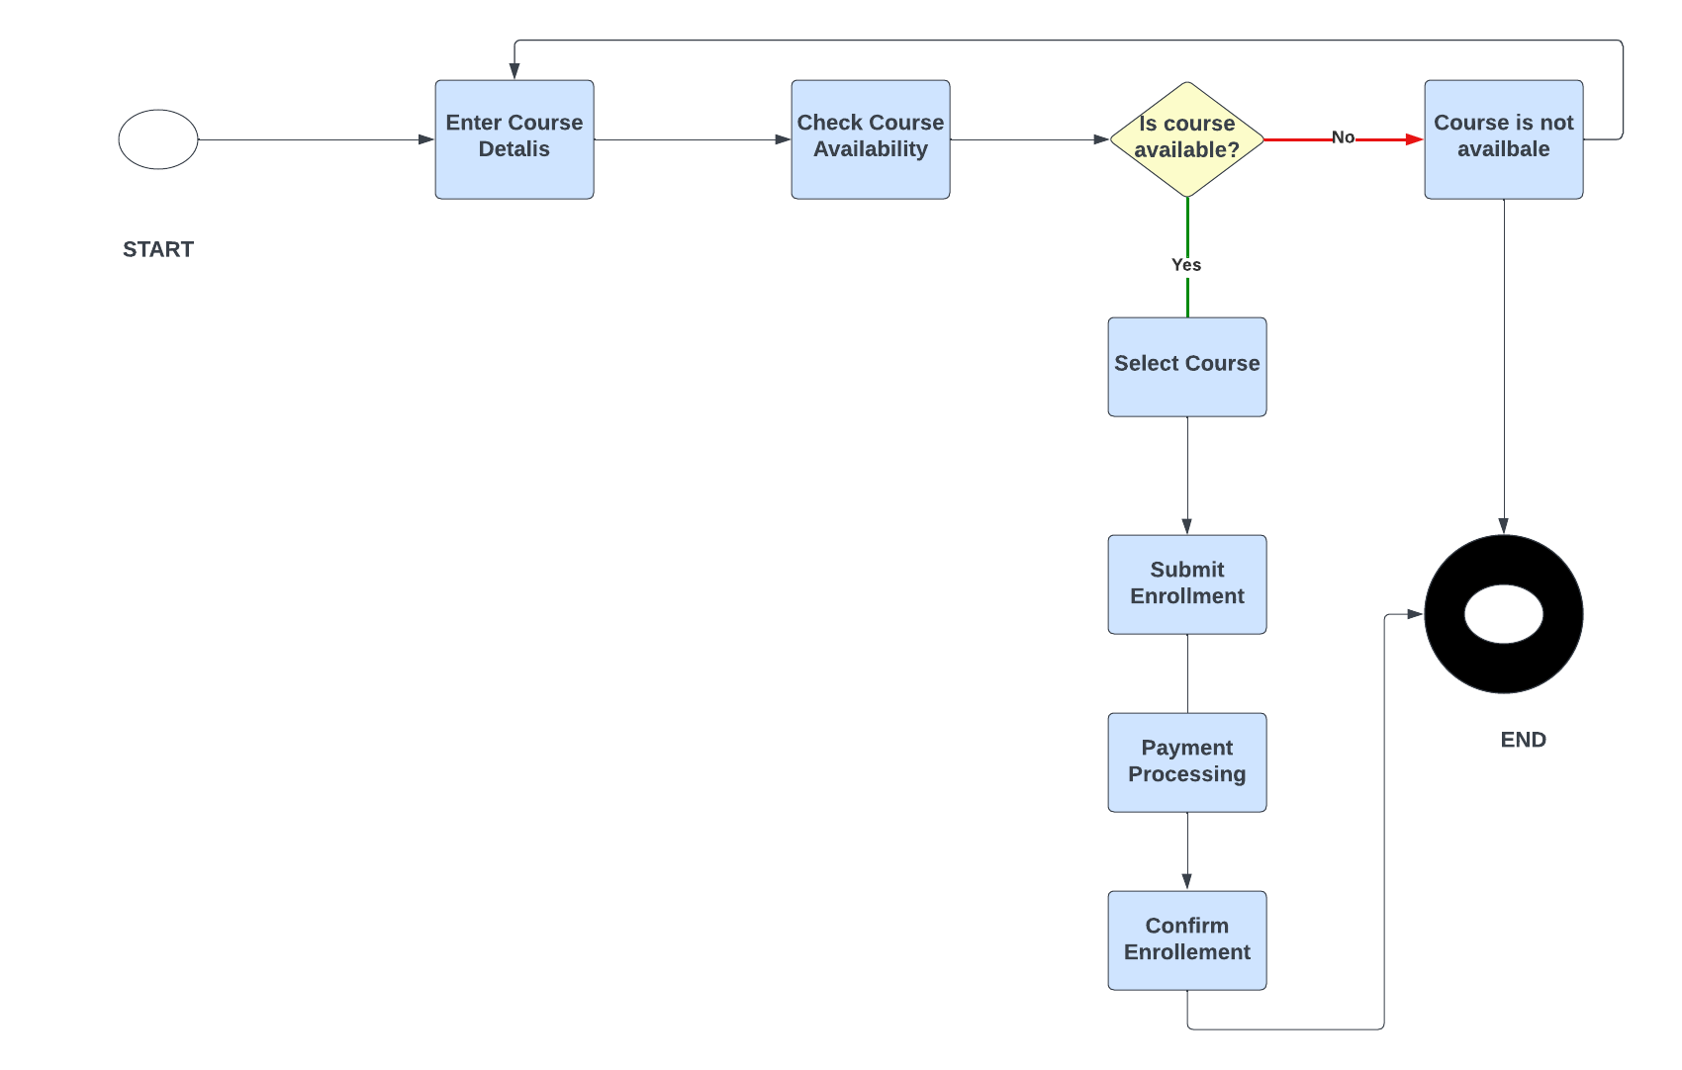
Continuing…

Slide 24
Thank You!
Do you have any questions?

